Slide 1
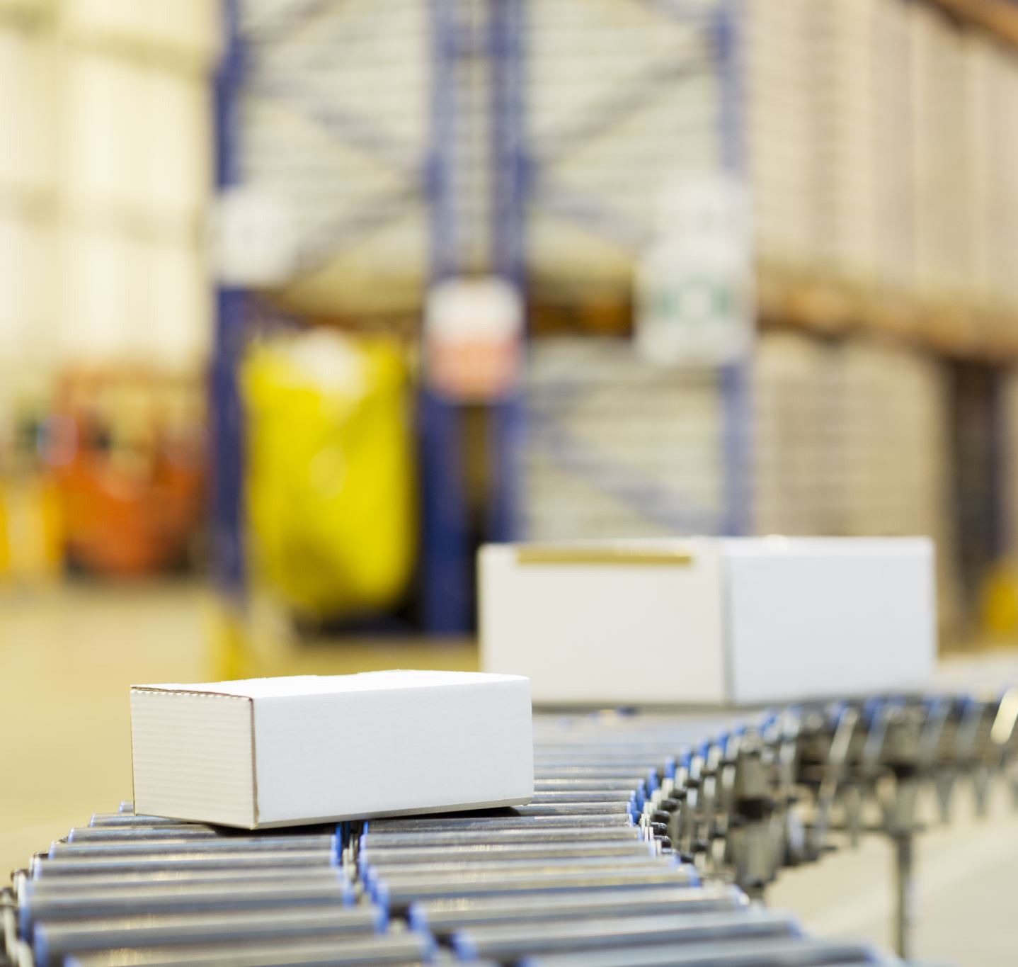
Automated Guided Vehicle
Group: N-10
53,54,55,56,57,58

Slide 2
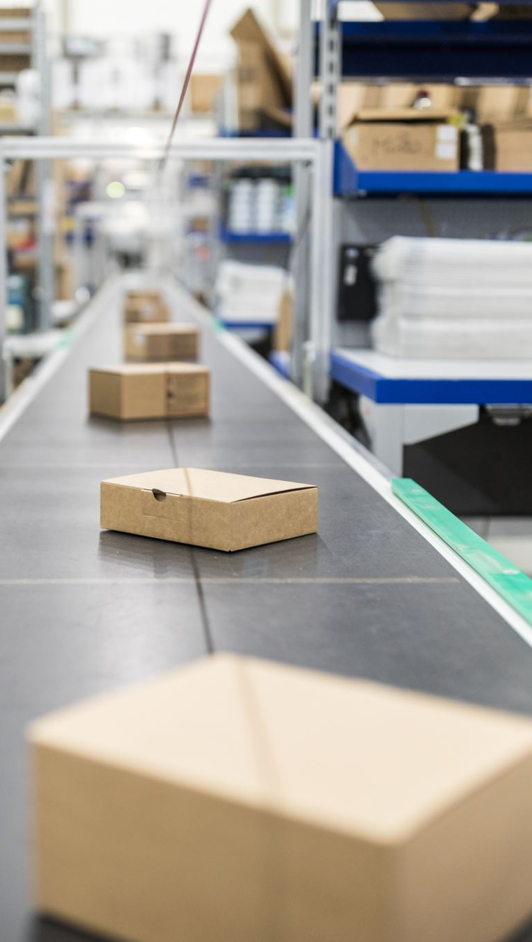
Introduction:
Automated Guided Vehicles (AGVs) are self-driving vehicles that are designed to transport goods or materials within a controlled environment, such as a warehouse, factory, or distribution center, without the need for human intervention. AGVs are typically equipped with sensors, navigation systems, and onboard computers to navigate and perform tasks autonomously.
AGVs have become increasingly popular in industries that require efficient and reliable material handling and transportation, as they can streamline operations, improve safety, and reduce labor costs.

Slide 3

Types of AGV’s
Unit Load AGVs: Designed to handle individual unit loads, such as pallets or containers, and autonomously transport them within a facility.
Tow AGVs: Designed to tow trailers or carts in a train-like configuration, commonly used in logistics and distribution processes.
Forklift AGVs: Equipped with forklift-like mechanisms to lift and transport loads, commonly used in warehouses and manufacturing facilities.
Pallet AGVs: Specifically designed for handling palletized loads, can be integrated with conveyor systems and other automation equipment.

Slide 4

Problem Statement:
Labor-intensive tasks: Many material handling tasks, such as moving heavy loads, repetitive tasks, and long-distance transport, require significant labor resources, leading to increased labor costs and potential risks of human errors and injuries.
Inefficiency in material handling: Traditional manual material handling methods can be time-consuming, prone to errors, and inefficient in terms of productivity and throughput, leading to delays in operations and reduced overall efficiency.
Safety concerns: Material handling tasks, such as lifting heavy loads or working in hazardous environments.

Slide 5
Objective:
Improve
Improve efficiency: AGVs aim to automate material handling tasks to improve operational efficiency by reducing delays, optimizing throughput, and eliminating idle times.
Enhance
Enhance safety: AGVs are designed to operate safely, reducing the risk of accidents, injuries, and human errors associated with manual material handling.
Increase
Increase productivity: AGVs can significantly increase productivity by reducing cycle times, optimizing material flow, and working seamlessly with other automation systems.
Reduce
Reduce labor costs: AGVs can help reduce labor costs by automating labor-intensive tasks, eliminating the need for breaks or shifts, and increasing operational time.

Slide 6
Advantages
Increased efficiency: AGVs can automate material handling tasks, reducing delays, optimizing throughput, and improving overall operational efficiency.
Enhanced safety: AGVs are designed to operate safely, reducing the risk of accidents, injuries, and human errors associated with manual material handling.
Higher productivity: AGVs can increase productivity by reducing cycle times, optimizing material flow, and working seamlessly with other automation systems.
Flexibility: AGVs offer flexibility to adapt to changing business needs, such as varying demand patterns, dynamic production schedules, and changing facility layouts.

Slide 7

Disadvantages:
High initial cost: AGV implementation can require significant upfront investment in equipment, software, and infrastructure.
Maintenance and downtime: AGVs, like any other automated system, require maintenance and may experience downtime, which can impact operations and require additional resources for maintenance and repairs.
Complex implementation: Implementing AGVs requires careful planning, system integration, and employee training, which can be complex and time-consuming.
Limited adaptability: AGVs may not be suitable for all material handling tasks or environments, and their adaptability may be limited in certain situations.

Slide 8

Conclusion:
AGVs are increasingly being used in material handling operations to improve efficiency, safety, and productivity.
AGVs offer advantages such as increased operational efficiency, enhanced safety, higher productivity, flexibility, labor cost savings, improved accuracy, and sustainability.
However, AGVs also have potential disadvantages, including high initial cost, maintenance and downtime, complex implementation, limited adaptability, potential job displacement, dependence on technology, and regulatory and legal considerations.
Despite the challenges, AGVs can be a valuable addition to modern material handling operations, particularly in industries with high-volume, repetitive, or labor-intensive tasks

